Slide 1


Big Data Best Practices and IPO Recommendations for Social Buzz

Slide 2


Today's agenda
Project recap
Problem
The Analytics team
Process
Insights
Summary

Slide 3

Social Buzz, a social media and content creation company, with their upcoming IPO and to audit their big data practices that are needed to adapt to it’s global scale. Accenture has taken the project and POC with a timeline of 3 months for the following tasks:
An audit of Social Buzz Big data practice
Recommendations for a successful IPO
An analysis of Social Buzz content categories that highlights the top 5 categories
Project Recap

Slide 4


Problem
Every day over 100,000 pieces of content, ranging
from text, images, videos and GIFs are posted
36,500, 000 per year pieces of content per Year
How to capitalize on it when there is so much data?
Analysis to find Social Buzz ‘s Top 5 most popular categories of content

Slide 5



Digvijay Singh
Data Analyst
The Analytics team
Marcus Romption
Senior Principal
Andrew Fleming
Chief Technical Architect

Slide 6
Process
1
Data Understanding
2
Data Cleaning
3
Data Modeling
4
Data Analysis
5
Uncover Insights

Slide 7

Insights
1738
REACTIONS TO “ANIMAL” POSTS
MAY
MONTH WITH MOST POST
16
UNIQUE CATEGORIES

Slide 8
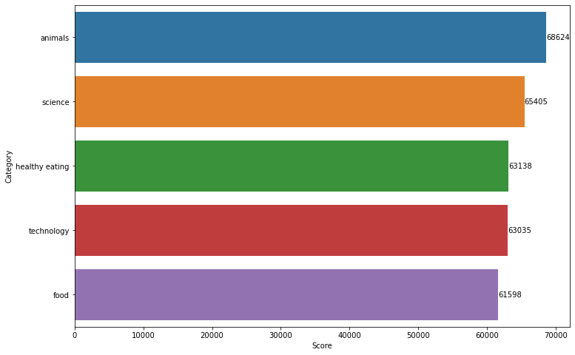
Top 5 Categories and there respective counts

Slide 9
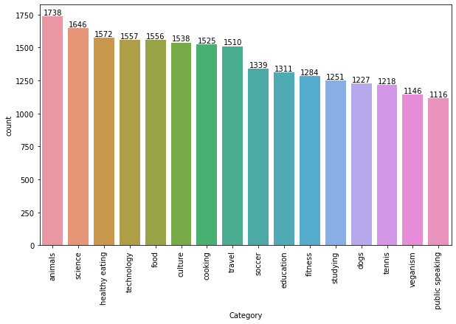
Number of Unique Categories

Slide 10
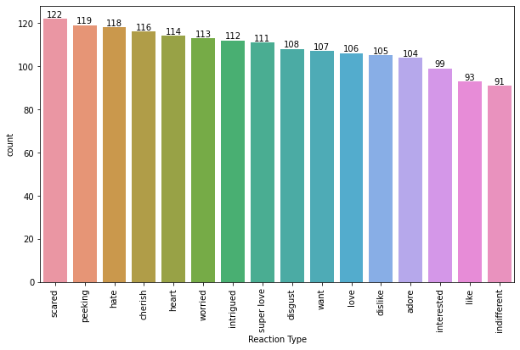
Count of Reactions of the most Popular Category “animals”

Slide 11
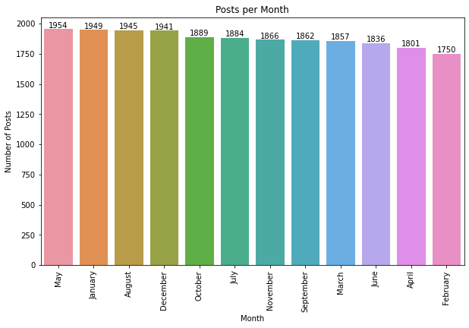
Counts of Posts per Month

Slide 12
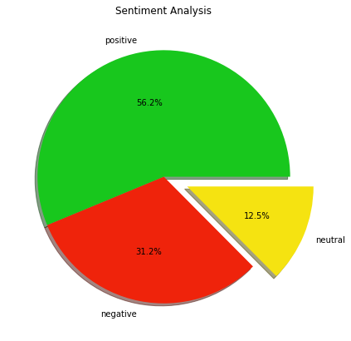
Sentiment Percentage of all the categories

Slide 13
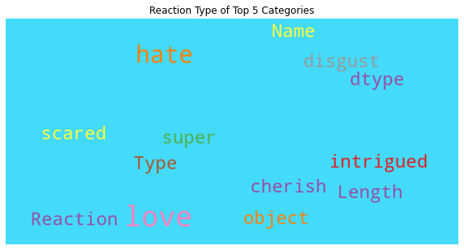
Top 5 Categories Reaction Types

Slide 14

Analysis
An Analysis of social Buzz’s content categories that higlights the top 5 categories.
Insights
The top 5 content categories observed from our data analysis were animals, science, healthy eating, technology, and food. One possible reason for the popularity of these categories could be due to the COVID-19 pandemic and the resulting lockdowns. For instance, the increased interest in animal-related content could be attributed to people spending more time at home with their pets. The surge in COVID-related content could explain the popularity of science-related content. Additionally, people who were unable to dine out may have turned to cooking and healthy eating content for inspiration, hence the popularity of healthy eating and food-related categories. Finally, with limited outdoor activities, people may have been consuming more technology content to stay entertained and connected.
Summary
Conclusion
The initial analysis is insightful and we can easily take it to the large scale production.

Slide 15

Thank you!
ANY QUESTIONS?

